Slide 1

APACHE WEB SERVER

Slide 2
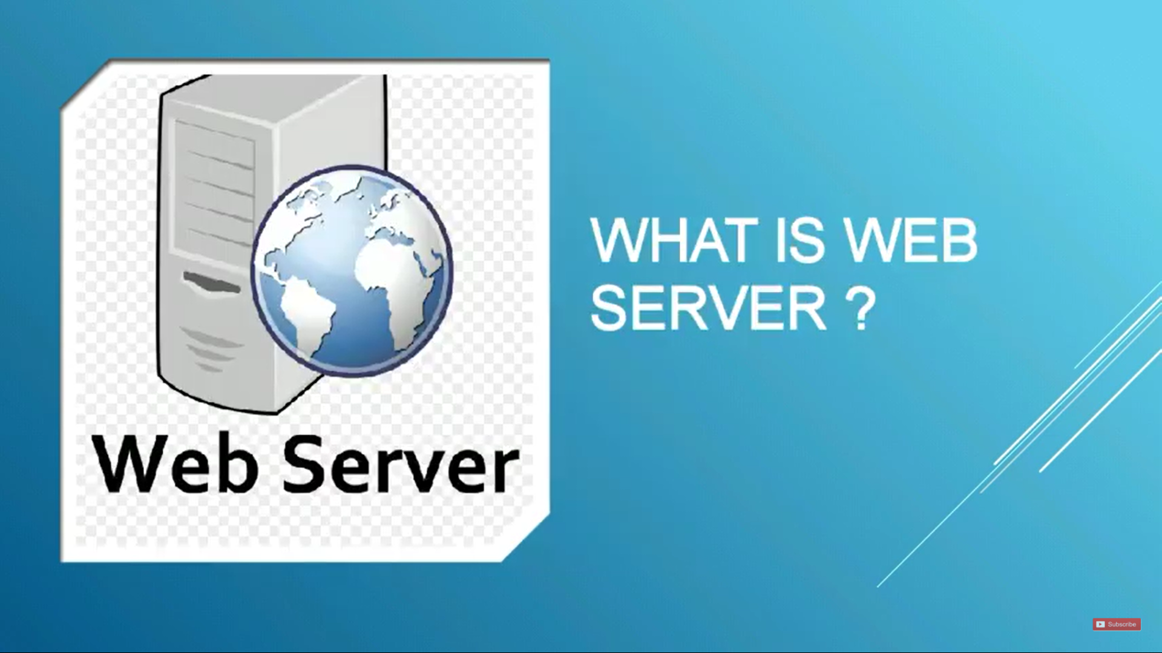
What is Web server ??

Slide 3
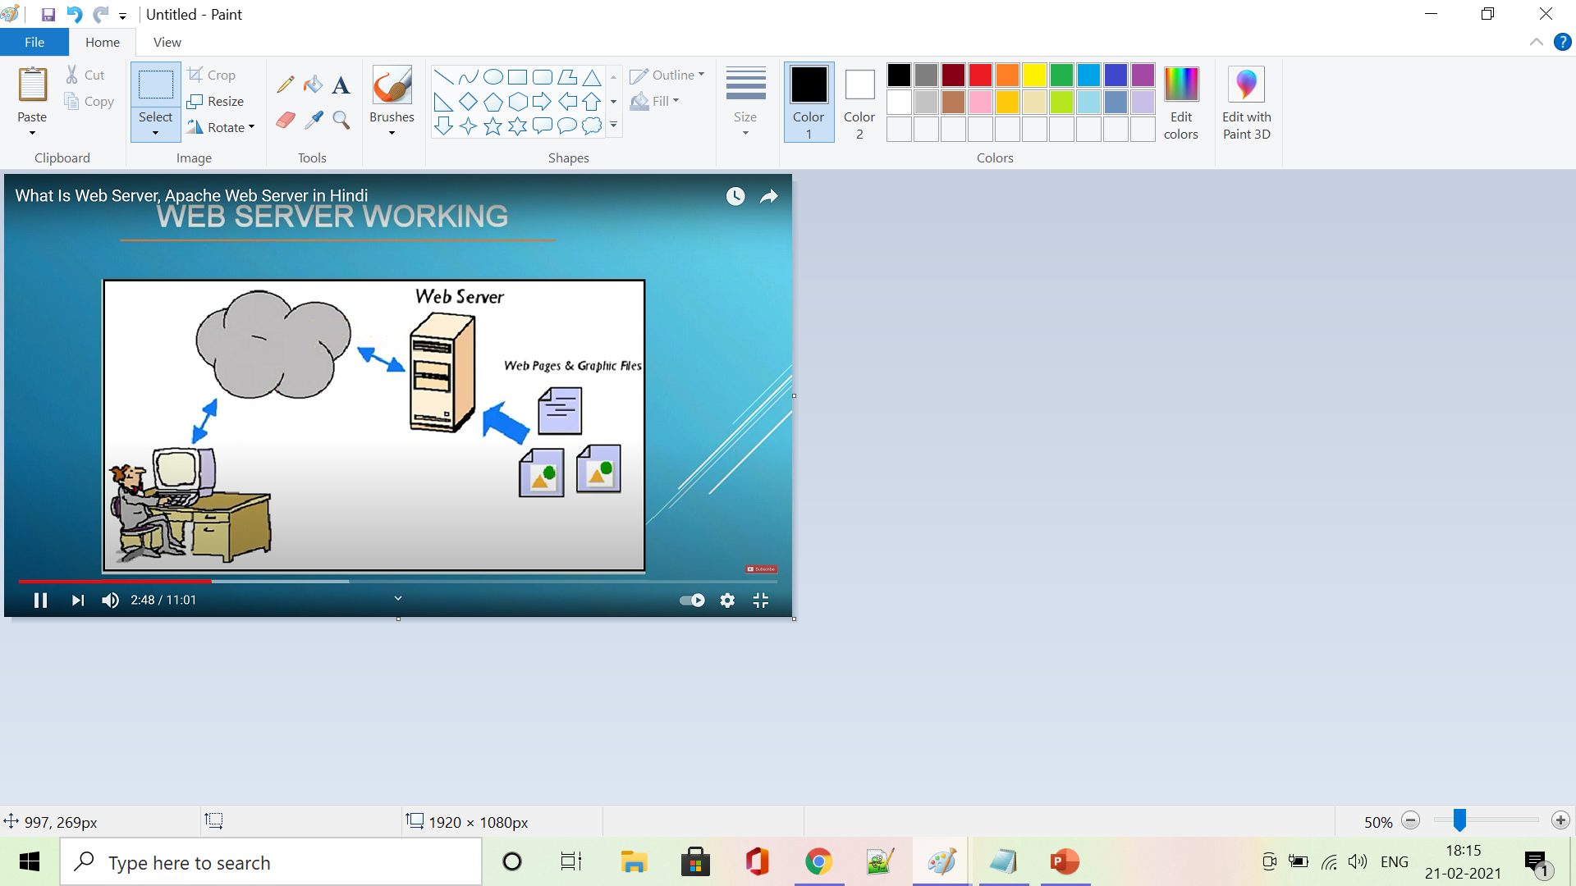
Web server
The word web server, can refer to the machine that receives request and sent out responses.
The basic objective of the web server is to store , process and deliver web pages to the users.
A web server’s job is basically to accept request from clients and send responses to those requests. A web server gets a URL, translates it to a filename, and sends that file back over the internet from the local disk of the server.
If the web server is not able to process and complete the request, it returns an error message.

Slide 4
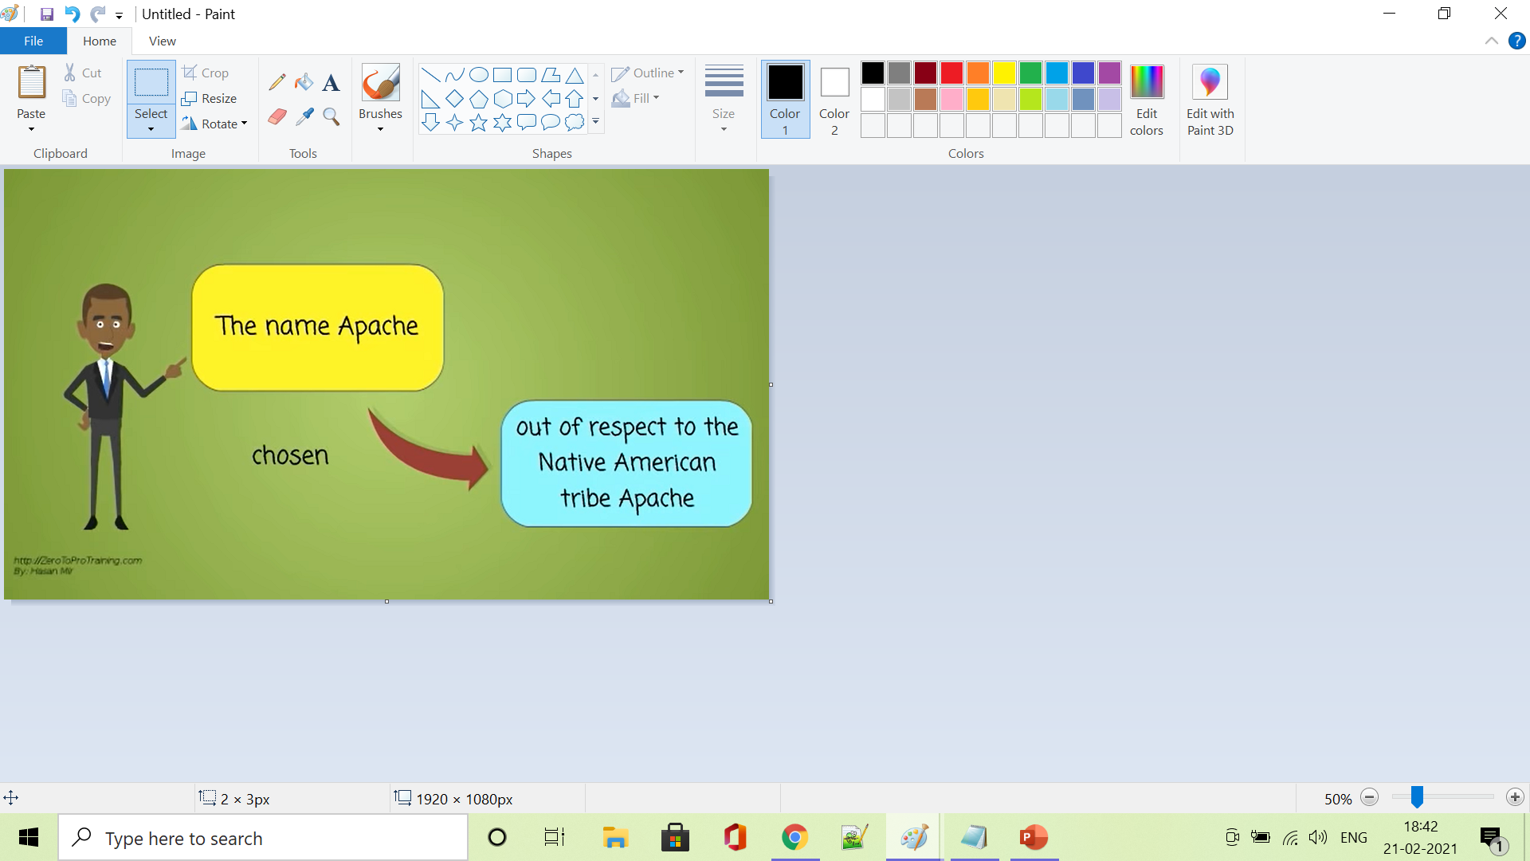

What is apache web server ??

Slide 5
APACHE Web server
Apache web server is a free and open-source cross-platform web server software, released under the terms of Apache License 2.0. Apache is developed and maintained by an open community of developers under the auspices of the Apache Software Foundation.
The apache is a software that runs in the background under an appropriate operating system , which proives services to other applications that connect to it ,such as client web browser.
Apache played a key role in the initial growth of the World Wide Web.
In 2009, it became the first web server software to serve more than 100 million websites.

Slide 6
APACHE Web server
It was first developed to work with Linus / Unix operating systems but was later adapted to work under other systems including Windows and MAC.
Originally based on the NCSA HTTPd server, development of Apache began in early 1995 after work on the NCSA code stalled, quickly overtaking NCSA HTTPd as the dominant HTTP server.

Slide 7
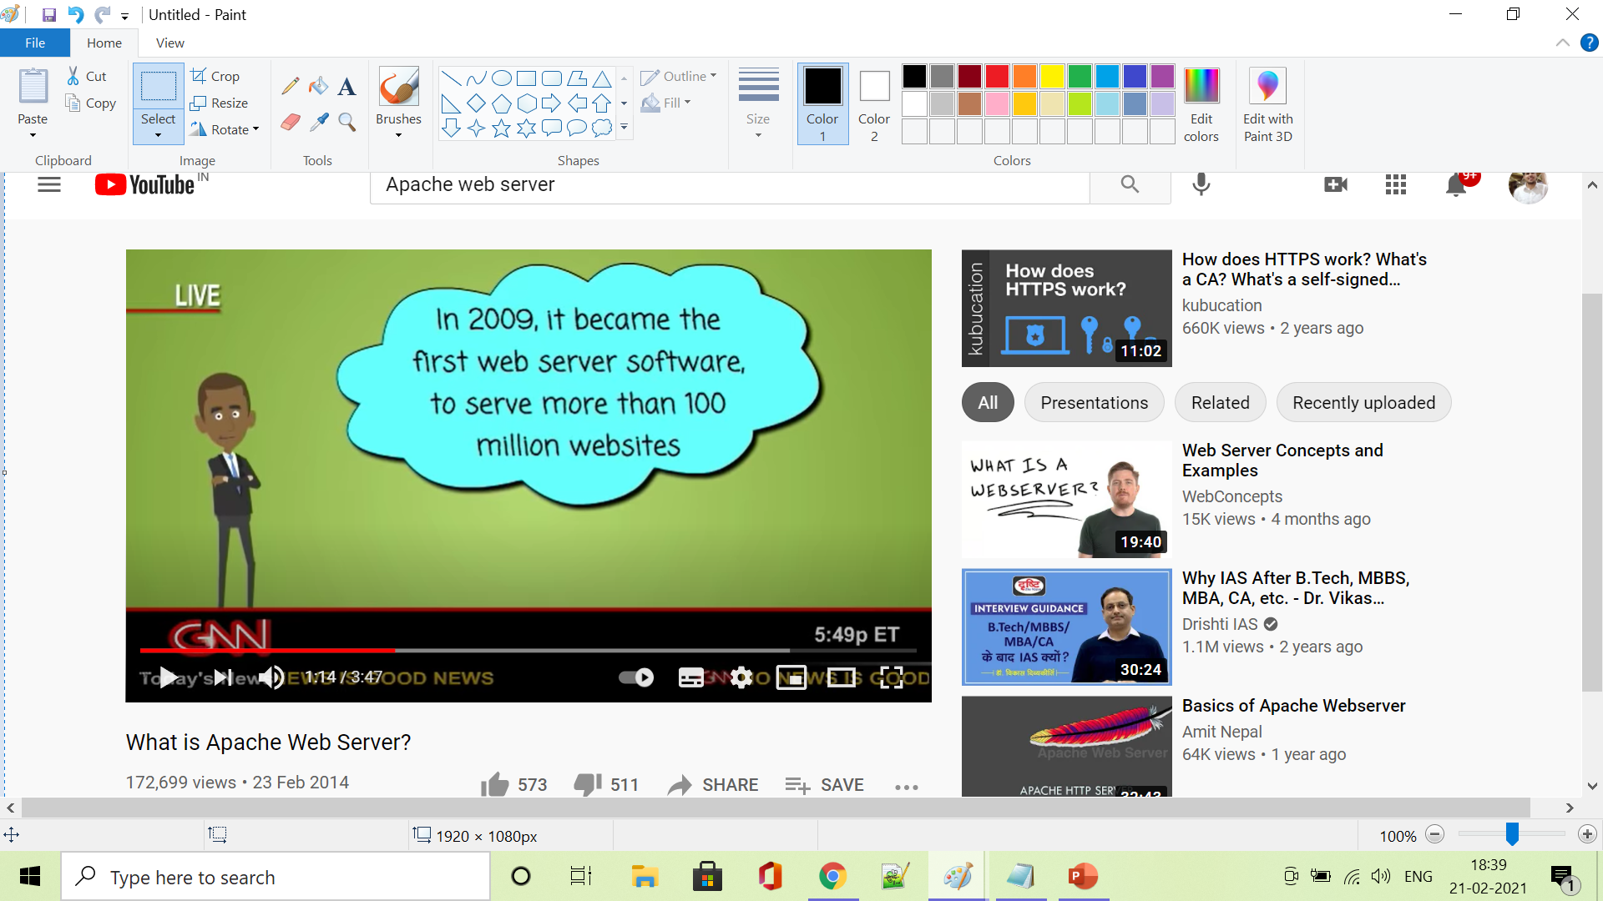
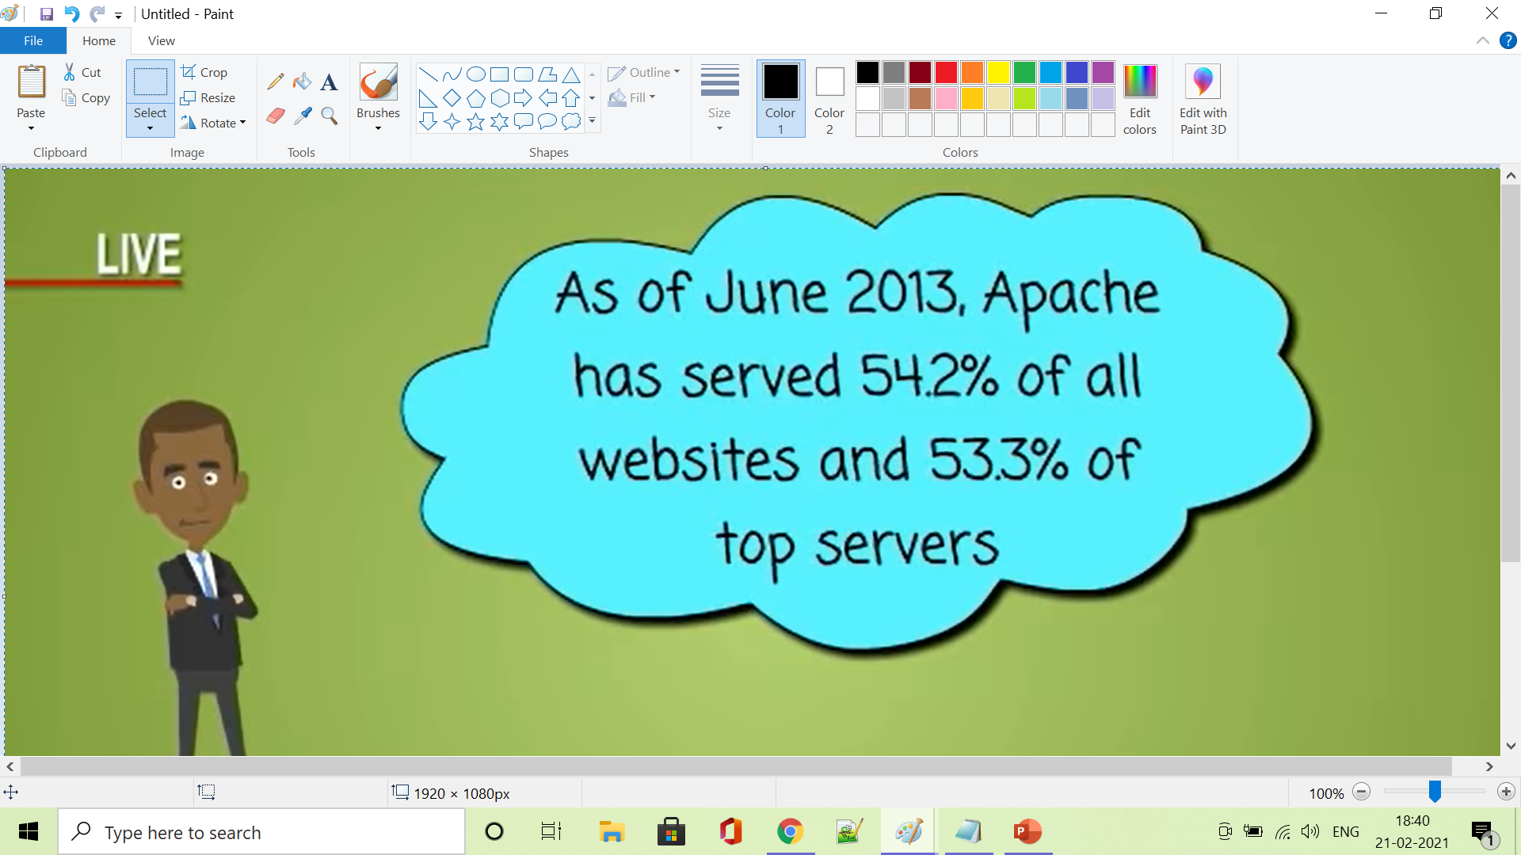
APACHE Web server
As of January 2021, Netcraft (Netcraft is an Internet services company based in England) estimated that Apache served 24.63% of the million busiest websites, while Nginx served 23.21% and Microsoft is in third place at 6.85%

Slide 8
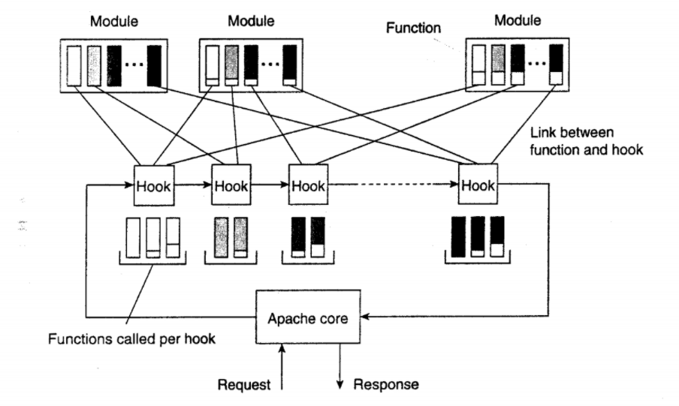
general organization of the Apache Web server

Slide 9
The Apache core makes few assumptions on how incoming requests should be handled.
HOOK : Hook is nothing but a placeholder for a specific group of functions. The Apache core assumes that requests are processed in a number of phases, each phase consisting of a few hooks. Each hook thus represents a group of similar actions that need to be executed as part of processing a request.
Example: There is a hook to translate a URL to a local file name.
MODULE : The functions associated with a hook are all provided by separate modules.

Slide 10
Features
Open source and free , even for commercial use.
Reliable , stable software.
Multiple Request Processing modes (MPMs).
Highly scalable.
Reverse proxy with caching.
Fault tolerance and Failover with automatic recovery.
Cross platform (works on both Unix and windows server).
Huge community and easily available support in case of any problem.

Slide 11
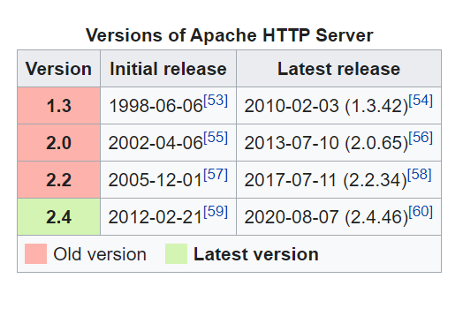
versions

Slide 12
Performance
Instead of implementing a single architecture, Apache provides a variety of Multi-Processing Modules (MPMs), which allow it to run in either a process-based mode, a hybrid (process and thread) mode, or an event-hybrid mode, in order to better match the demands of each particular infrastructure.
Apache is designed to reduce latency and increase throughput relative to simply handling more requests.

Slide 13
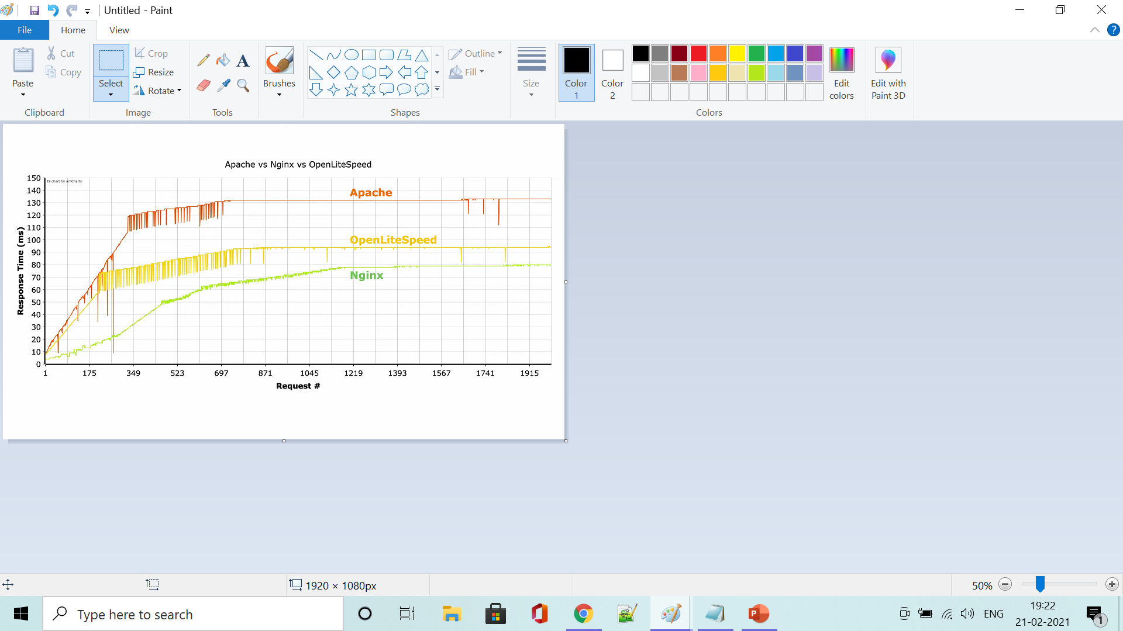
Apache vs Nginx vs openLitespeed

Slide 14
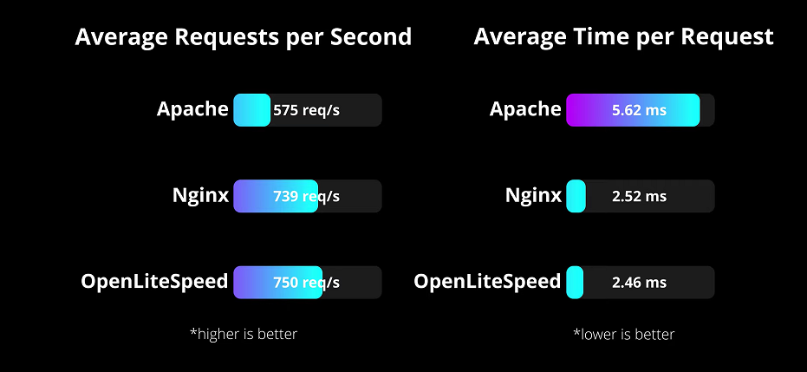

Slide 15
Thank you !!!

